Slide 1
CS-172 Final Project
By: Patrick & Michael

Slide 2
Description
Uses File I/O to import instructions (input dependent)
Can read in any text based file
Reads in text and translates into movement
Dog and ball move across screen, instruction-by-instruction
Update() function

Slide 3
Key Feature
Due to the way the file input is set up, anybody can create a set of instructions and then once the program is ran it prompts the user to input the file. Then one can read in those instructions and convert them into actual movement.

Slide 4
Challenges
Developing a language (for the file) to distinguish instructions and convert them into movement.
(later on challenge) - Timing, so when the program reads in the instructions it executes the movements with a slight pause in between.

Slide 5
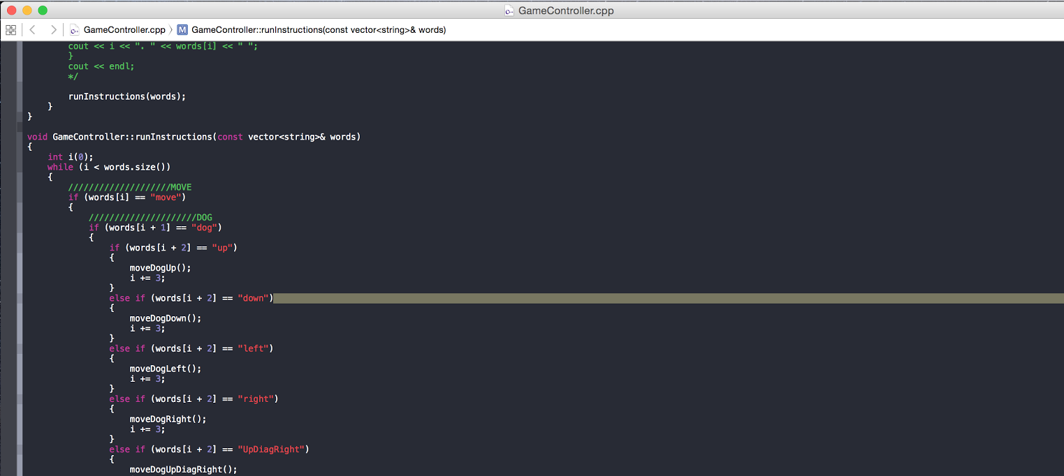
Solutions No. 1
For the language section, we used a keyword based approach. Where the program has to see “move” -> then the actor “Ball or dog” -> then the direction.
* Uses nested “if” statements

Slide 6
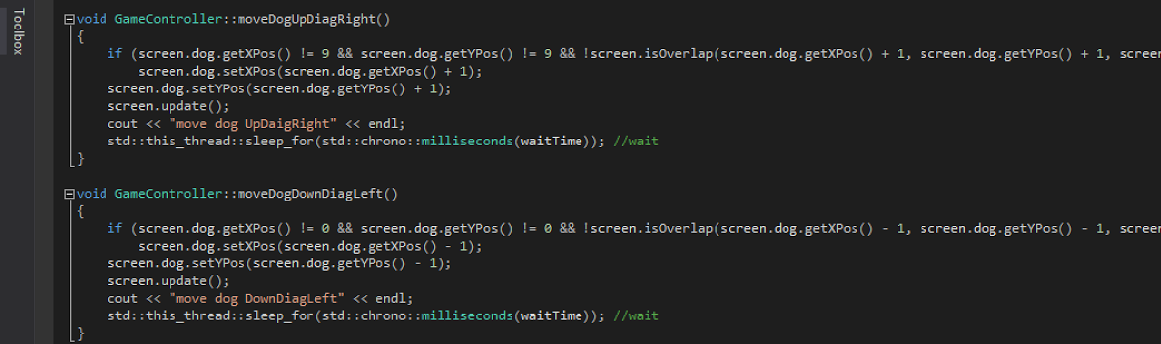
Solution No. 2
As for the timing problem we had to use a sleep function that need to be researched. To solve this we used:
#include <chrono>
std::this_thread::sleep_for(std::chrono::milliseconds(waitTime)); //wait
This was included in each of our functions, which would cause the program to pause for a given time and then proceed to the next function.

Slide 7
Demonstration
Let’s create some commands! :D

